Slide 1

Airbnb Data Analysis
Presented by Neda Sania

Slide 2
Introduction
Embarking on a data exploration journey, my role as a BI Analyst is to thoroughly examine Airbnb's data landscape, unraveling insights into user experiences and satisfaction. This involves scrutinizing district location scores and understanding the correlation between host response times and overall ratings. The process includes creating visualizations for Airbnb listing prices, analyzing composite scores, and calculating listing age and host tenure. The culmination of this journey involves a detailed examination of listing prices, guest ratings, and visitor trends in a comprehensive City Insights Report, with a specific focus on discerning the significant changes in 2020 compared to earlier years. This endeavor aims to provide a nuanced and professional perspective on Airbnb's data dynamics.

Slide 3
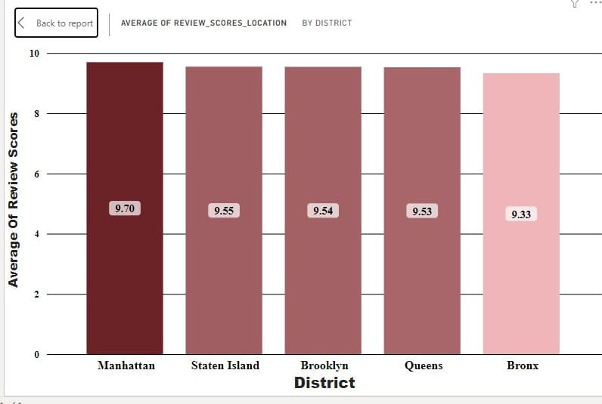
Assessing District Location Scores:
Analyzing the district location scores, it's evident that the Bronx has the least favorable location score among the districts, standing at 9.33.
This information is crucial for hosts and Airbnb stakeholders looking to identify areas for improvement.
While Manhattan boasts the highest score of 9.70, the focus should shift to addressing the aspects affecting the Bronx's location perception to enhance the overall competitiveness of Airbnb listings in that district.
Implementing targeted improvements in the Bronx can contribute to a more balanced and satisfactory experience for guests, thereby positively influencing the district's reputation and desirability.

Slide 4
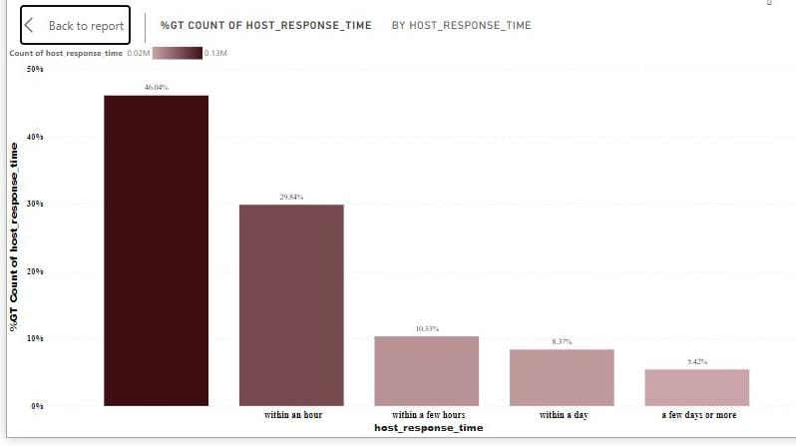
Examining Host Response Time Impact:
46.04% of Airbnb listings lack specified response times, showcasing variability in communication practices.
29.84% of listings prioritize quick responses 'within an hour,' potentially influencing positive guest experiences.
10.33% commit to responding 'within a few hours,' and 8.37% within a day, indicating a moderate emphasis on timely communication.
5.42% of listings indicate longer response times, possibly affecting guest satisfaction.
The correlation between host response times and overall ratings requires further exploration, with swift responses likely positively influencing ratings and clarifying communication expectations enhancing the overall guest experience.

Slide 5
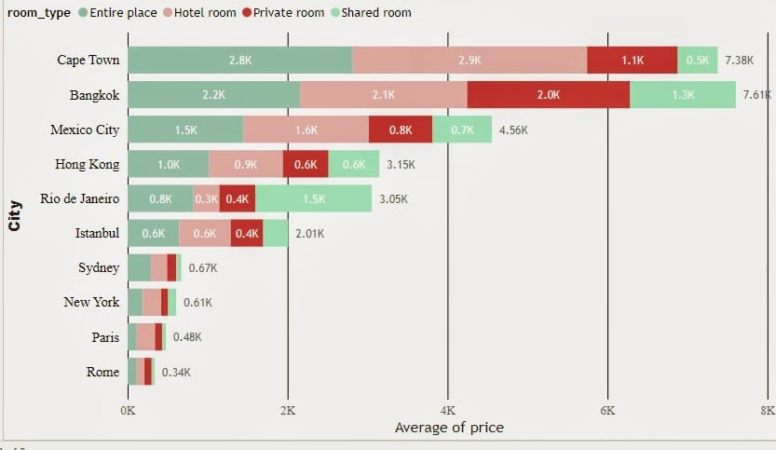
Exploring Listing Prices: Trends and Insights Across Global Cities
Cape Town exhibits the highest prices for Entire place and Hotel room, while Bangkok boasts the highest prices for Private room and Shared room.
Paris tends to have comparatively lower average prices for all types of rooms.
Hong Kong and Sydney exhibit notable price variations among different room types, while Rio de Janeiro shows a considerable contrast between Entire place and Hotel room prices.
Shared room is typically the most budget-friendly choice, whereas Entire place and Hotel room options tend to be pricier compared to Private room and Shared room.
Diverse pricing trends are observed across various regions, exemplified by distinct pricing patterns in cities like Cape Town and Bangkok.
Cities such as Paris and New York feature generally lower prices across all room types, while Rio de Janeiro exhibits a comparatively lower price for Entire place compared to other types.

Slide 6
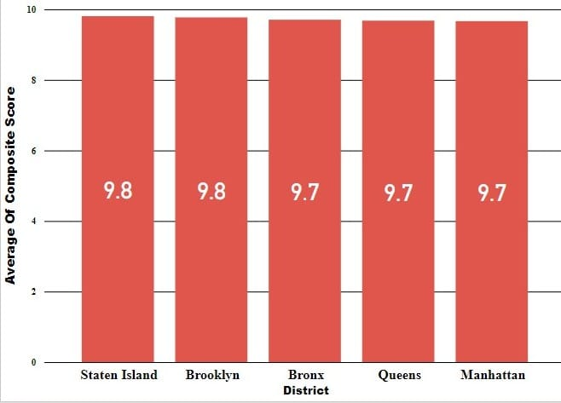
Analyzing Airbnb Composite Scores for Check-in and Communication:
Staten Is Implemented a straightforward mean calculation of check-in and communication scores to establish a composite land stands out with the highest composite score of 9.81, showcasing exceptional integration of check-in experience and host communication.
Brooklyn follows closely with a notable score of 9.77, emphasizing a consistent positive trend in composite scores across various districts.
The Bronx and Queens also exhibit commendable scores of 9.71 and 9.68, respectively, indicating a competitive performance in guest satisfaction.
Although slightly lower, Manhattan maintains a solid average composite score of 9.67, reinforcing a high standard in check-in experience and host communication

Slide 7
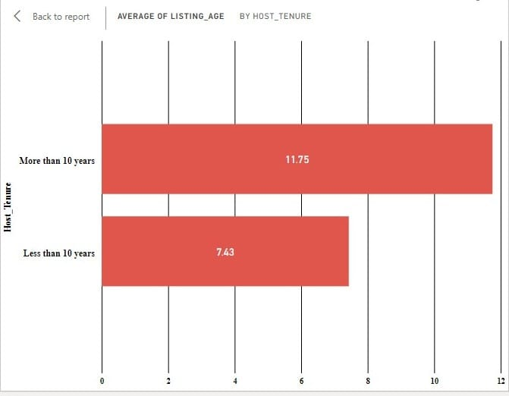
Analyzing Listing Age and Host Tenure Trends
To achieve the objective of calculating Listing Age and identifying hosts with more than ten years of hosting expertise first In the "Data" view, create a new calculated column for Listing Age using the following DAX formula:Listing_Age = DATEDIFF([host_since], TODAY(), YEAR)
This formula calculates the age of the listing in years based on the "host_since" date.
Create another calculated column for Host Tenure using the following DAX formula:
Host_Tenure = IF( DATEDIFF([host_since], TODAY(), YEAR) > 10,"More than 10 years","Less than 10 years")
This formula categorizes hosts based on whether they have more than 10 years of hosting expertise.
After generating a bar chart, further analysis reveals the following insights:
The average listing age for hosts with more than 10 years of tenure is notably higher at 11.75 years. This indicates that experienced hosts tend to have older listings, potentially reflecting a stable and enduring presence in the Airbnb hosting community.
In contrast, hosts with less than 10 years of tenure have a lower average listing age of 7.43 years. This suggests that newer hosts have relatively younger listings, possibly indicating a more recent entry into the Airbnb hosting platform.
The observed differences in average listing age between hosts with different tenures highlight a correlation between hosting experience and the age of listings. This information can be valuable for understanding the dynamics of host tenure and its impact on the longevity of Airbnb listings.

Slide 8
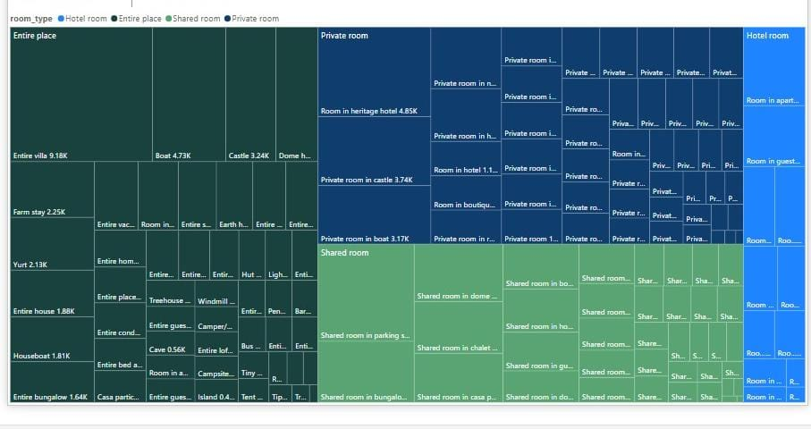
Decoding Prices Across Property Types
In the "Entire Place" category, "Entire villa" stands out with the highest average price of 9.18K USD.
A visual tree map efficiently conveys the distribution of prices for various room and property types.
The focus on "Entire villa" indicates its association with higher-end accommodations, offering valuable insights for hosts and guests alike.
This information aids hosts in pricing strategies and assists guests in selecting accommodations aligned with their preferences and budget.

Slide 9
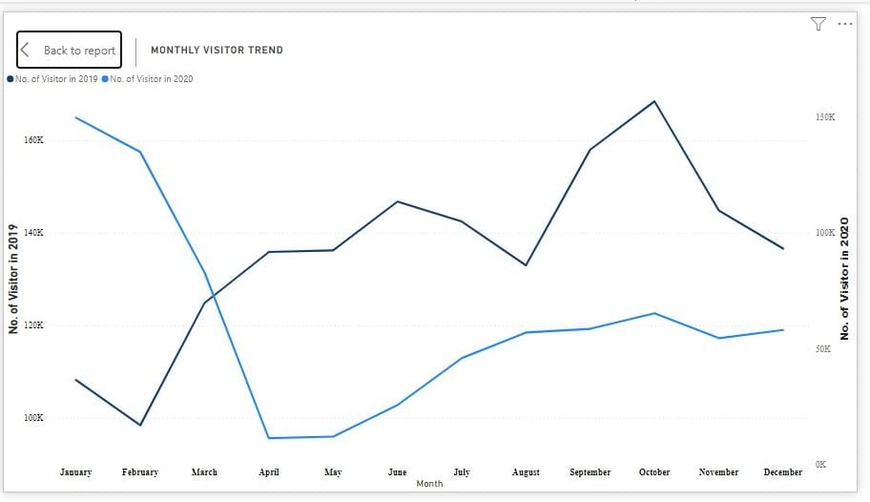
Visitor Trends: A Comparative Analysis of 2019 and 2020
Monthly visitor counts increased from January to March in 2019, but this growth was disrupted in March 2020.
Subsequent months in 2020 witnessed a significant decline, especially in June, reflecting the influence of the COVID-19 pandemic on reduced travel.
September 2020 showed a slight recovery compared to the previous months, indicating some resilience, yet overall visitor numbers remained below the corresponding months in 2019.

Slide 10
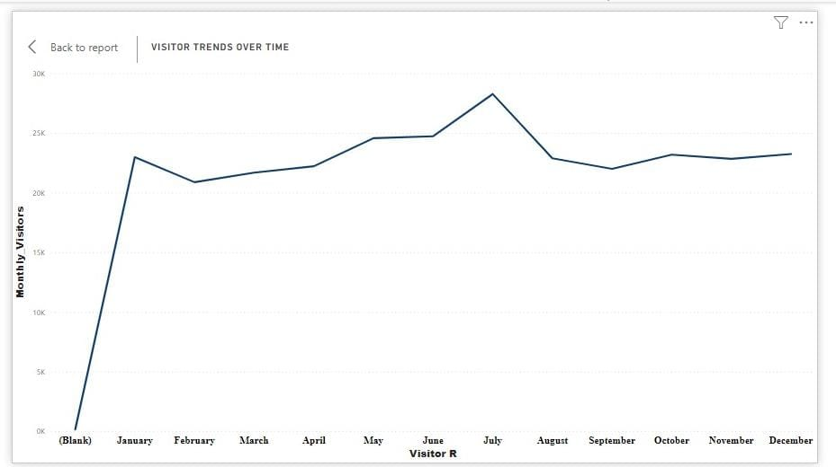
Monthly Visitors Analysis:
Seasonal patterns with peak activity in July.
Winter dip in December and February.
Consistent mid-year growth from March to July.
Stable fall months from September to November.
Influencing factors like holidays and events should be considered.
Opportunities for targeted marketing during peak seasons.
Data quality check and year-to-year comparisons are essential.
Potential for future predictions based on historical data.

Slide 11
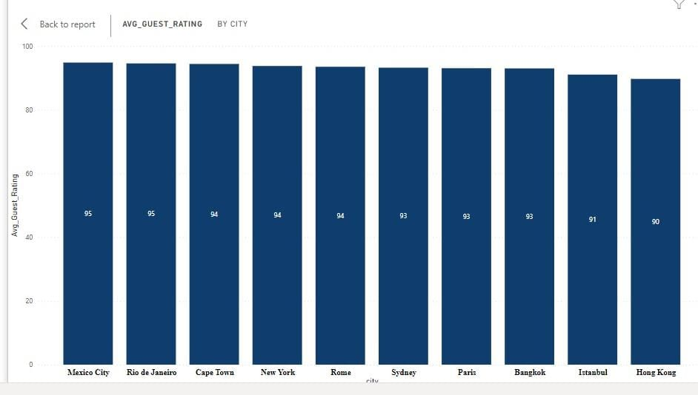
Average Guest Ratings for Cities:
Top-rated cities include Mexico City, Rio de Janeiro, and Cape Town.
Middle-range ratings for New York, Rome, Sydney, and Paris.
Lower ratings for Bangkok and Istanbul.
Significant variation in ratings across cities.
Potential influencing factors include cultural differences and service standards.
Impact on tourism and competitive advantage for highly rated cities.
Areas for improvement in cities with lower ratings.
Continuous monitoring and benchmarking against industry standards

Slide 12
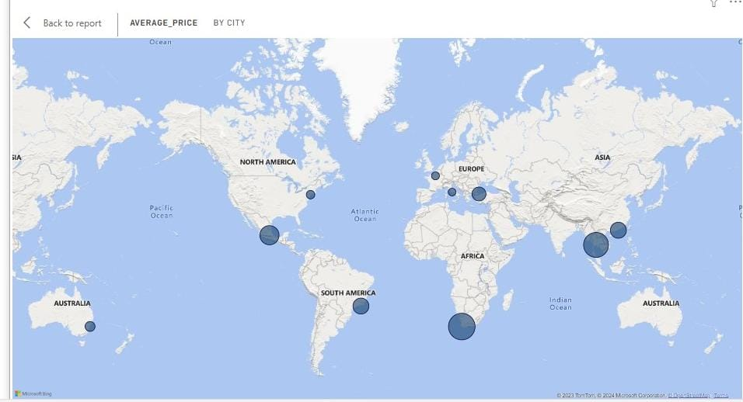
Average Listing Prices for Cities:
High-cost cities like Cape Town and Bangkok.
Moderate to low-cost cities include Mexico City, Hong Kong, and Rio de Janeiro.
Budget-friendly cities such as Sydney, New York, Paris, and Rome.
Potential correlation between prices and guest ratings.
Factors influencing prices include demand and local economic conditions.
Competitive landscape considerations based on pricing.
Impact on tourism demographics.
Adjustment strategies for cities with high or low prices.
Continuous monitoring of pricing trends in a dynamic market.

Slide 13

Conclusion
The analysis of Airbnb data reveals valuable insights across multiple dimensions. Seasonal patterns in monthly visitors highlight peak activity during summer, offering opportunities for targeted marketing. The guest ratings showcase a diverse landscape, with top-rated cities like Mexico City and Rio de Janeiro, emphasizing the impact on tourism and the need for continuous monitoring. Examining average listing prices indicates a range from high-cost cities like Cape Town to budget-friendly destinations like Sydney, suggesting the importance of market dynamics and strategic adjustments. Altogether, a holistic approach, including year-to-year comparisons, data quality checks, and feedback loops, is crucial for Airbnb's sustained success in the competitive hospitality industry.

